Slide 1
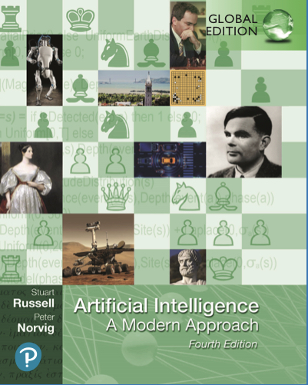
What is artificial intelligence? -and a wee bit of history
AI for the Arts and Humanities (A)
Yunhyong Kim & John McKechnie

Slide 2
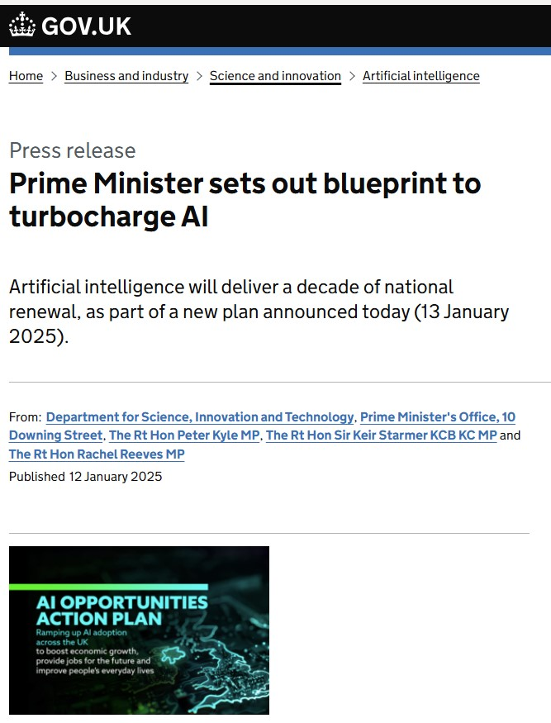
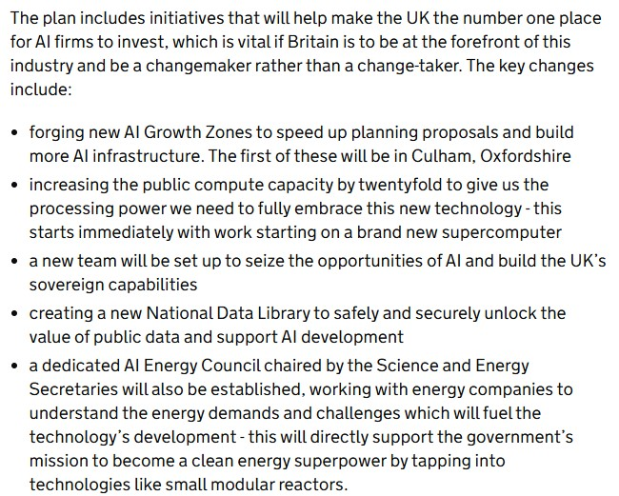
In the News (2025 January 13)
Prime Minister sets out blueprint to turbocharge AI - GOV.UK

Slide 3
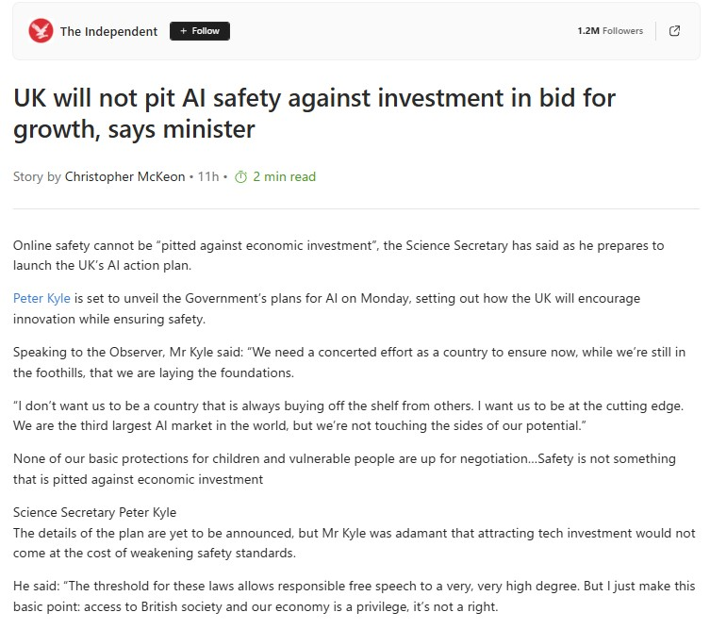
In the News (2025 January 11)
https://www.independent.co.uk/news/uk/politics/peter-kyle-government-elon-musk-donald-trump-mark-zuckerberg-b2678007.html

Slide 4
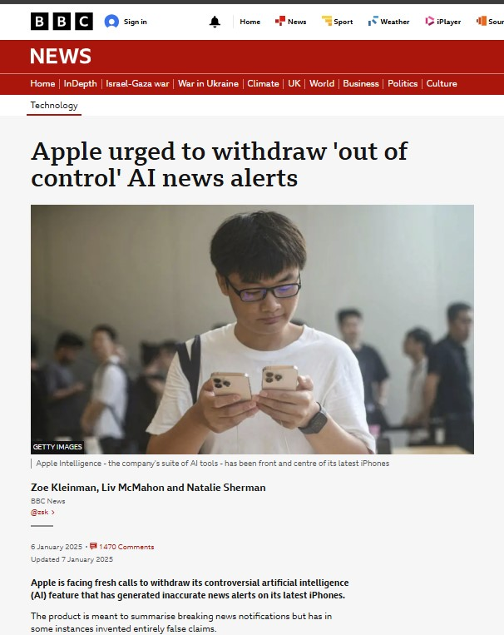
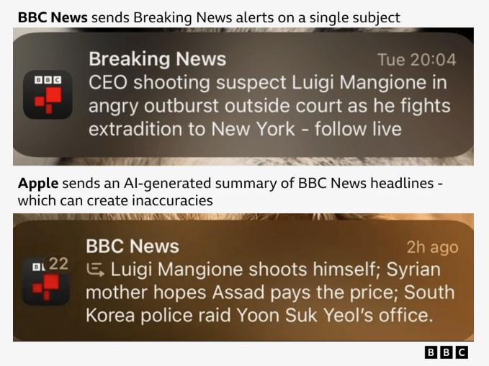
In the News (2025 January 7)
https://www.bbc.co.uk/news/articles/cge93de21n0o

Slide 5
Early influences
Aristotle (c. 384 -322 BCE) formulated laws governing the rational mind.
Ramon Llull (c. 1232 – 1315 ) devised a “machine” of paper wheels as a system with which to reason.
Thomas Hobbes (1651) in his book Leviathan, talked of “artificial animals”.
René Decartes (1596 - 1650) on rationalism, Francis Bacon (1561 – 1626) and John Locke (1632 – 1704) on empiricism, David Hume (1711 -1776) and Immanuel Kant (1785) on induction, and Ludwig Wittgenstein and Bertrand Russell on logical positivism, Jeremy Bentham (1832) and John Stuart Mill (1863)on utilitarianism.
Formal logic of George Boole (1815 -1925) and Gottlob Frege (1848 -1925) led to first order logic which is a bedrock of earlier knowledge-based systems.
Probability theory of Gerolamo Cardano (c. 1501 -1576) and Blaise Pascal (c. 1623-1662), and, later, the rules of Thomas Bayes (c. 1702 -1761) forms a crucial tool for AI.
Some popular machine learning algorithms such as linear regression (we will learn more about this shortly) was first used for predicting planetary motions by Adrien- Marie Legendre (c. 1752 – 1833) and Karl Friedrich Gauss (1777 -1855), the term being coined by Francis Galton in 1886.

Slide 6
Defining the field
“The field of artificial intelligence, or AI, is concerned with not just understanding but also building intelligent entities – machines that can compute how to act effectively and safely in a wide variety of novel situations.”
Understand learning, reasoning, and perception while achieving specific objectives such as playing chess, proving mathematical theorems, writing poetry, driving a car, diagnosing disease.
Tackle a variety of tasks such as describing what’s happening in a video, question answering, robots operating in a factory, real time translation, visual recognition of objects, optimization of investment and trading, and voice/speech recognition.
Russell and Norvig (2022) “Artificial Intelligence: A Modern Approach” - https://go.exlibris.link/gLPtwSVC

Slide 7
Defining the field
“The field of artificial intelligence, or AI, is concerned with not just understanding but also building intelligent entities – machines that can compute how to act effectively and safely in a wide variety of novel situations.”
Understand learning, reasoning, and perception while achieving specific objectives such as playing chess, proving mathematical theorems, writing poetry, driving a car, diagnosing disease.
Tackle a variety of tasks such as describing what’s happening in a video, question answering, robots operating in a factory, real time translation, visual recognition of objects, optimization of investment and trading, and voice/speech recognition.
Russell and Norvig (2022) “Artificial Intelligence: A Modern Approach” - https://go.exlibris.link/gLPtwSVC

Slide 8
Defining the field
“The field of artificial intelligence, or AI, is concerned with not just understanding but also building intelligent entities – machines that can compute how to act effectively and safely in a wide variety of novel situations.”
Understand learning, reasoning, and perception while achieving specific objectives such as playing chess, proving mathematical theorems, writing poetry, driving a car, diagnosing disease.
Tackle a variety of tasks such as describing what’s happening in a video, question answering, robots operating in a factory, real time translation, visual recognition of objects, optimization of investment and trading, and voice/speech recognition.
Russell and Norvig (2022) “Artificial Intelligence: A Modern Approach” - https://go.exlibris.link/gLPtwSVC

Slide 9
Defining the field
“The field of artificial intelligence, or AI, is concerned with not just understanding but also building intelligent entities – machines that can compute how to act effectively and safely in a wide variety of novel situations.”
Understand learning, reasoning, and perception while achieving specific objectives such as playing chess, proving mathematical theorems, writing poetry, driving a car, diagnosing disease.
Tackle a variety of tasks such as describing what’s happening in a video, question answering, robots operating in a factory, real time translation, visual recognition of objects, optimization of investment and trading, and voice/speech recognition.
Russell and Norvig (2022) “Artificial Intelligence: A Modern Approach” - https://go.exlibris.link/gLPtwSVC

Slide 10
What is AI?
“The exciting new effort to make computers think ... machines with minds, in the full and literal sense.” (Haugeland, 1985)
“[The automation of] activities that we associate with human thinking, activities such as decision making, problem solving, learning ...” (Bellman, 1978)
“The art of creating machines that perform functions that require intelligence when performed by people.” (Kurzweil, 1990)
“The study of how to make computers do things which, at the moment, people are better.” (Rich and Knight, 1991)
“The study of mental faculties through the use of computational models.”(Charniak and McDermott, 1985)
“The study of the computations that make it possible to perceive, reason and act.” (Winston, 1992)
“Computational Intelligence is the study of the design of intelligent agents.” (Poole et al, 1998)
“AI ... is concerned with intelligent behavior in artifacts.” (Nilsson, 1998)

Slide 11
What is AI?
“AI is the ability of a machine to display human-like capabilities such as reasoning, learning, planning and creativity.” https://www.europarl.europa.eu/news/en/headlines/society/20200827STO85804/what-is-artificial-intelligence-and-how-is-it-used
“Whilst there is no universal definition of AI, it can be considered as an evolving set of technologies that enable computers to simulate elements of human behaviour such as learning, reasoning and classification, by analysing data to model some aspect of the world and predict and anticipate possible future events.” https://commonslibrary.parliament.uk/research-briefings/cbp-8152/
“The Artificial Intelligence Act (AIA) defines AI broadly as a suite of software development frameworks that encompass machine learning, expert and logic systems, and Bayesian or statistical approaches.” https://datainnovation.org/2021/05/the-artificial-intelligence-act-a-quick-explainer/

Slide 12
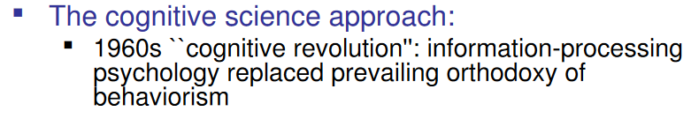
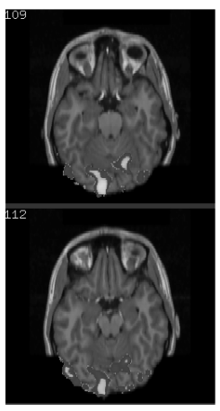
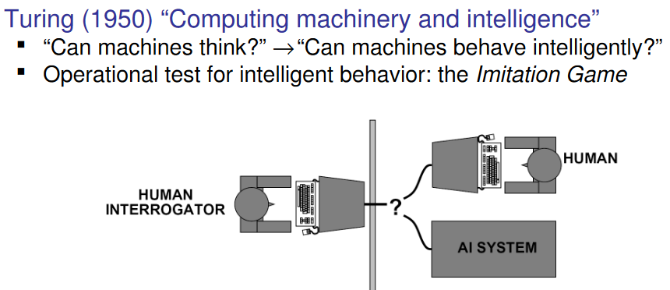
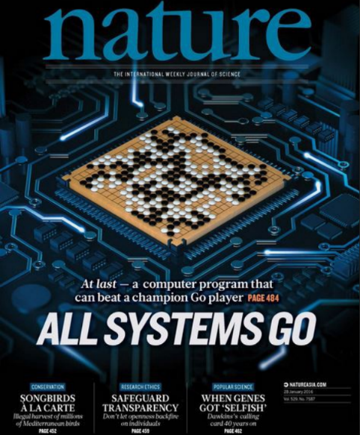
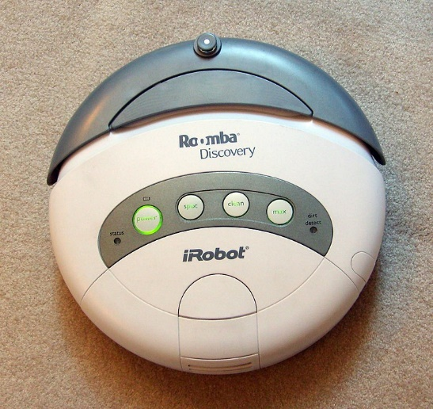
Taxonomy of AI
Act Human
Think Human
Act Rationally
Think Rationally
By Shawnc - Own work, Public Domain, https://commons.wikimedia.org/w/index.php?curid=2636046

Slide 13
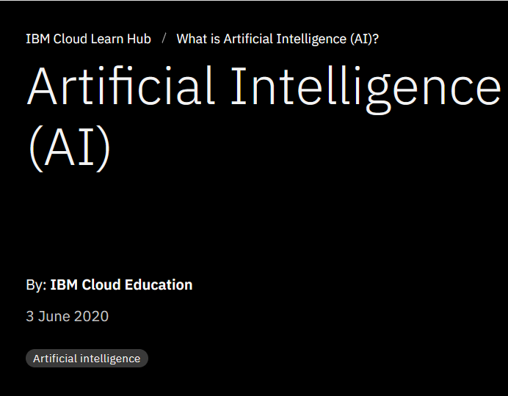
Measuring Intelligence
Artificial Narrow/Weak Intelligence – AI trained to perform specific tasks.
Artificial General/Strong Intelligence – trained to learn any task or at least wide variety of tasks and/or “where a machine would have an intelligence equal to humans; it would have a self-aware consciousness that has the ability to solve problems, learn, and plan for the future.”
Artificial Super Intelligence – “would surpass the intelligence and ability of the human brain”
https://www.ibm.com/cloud/learn/what-is-artificial-intelligence

Slide 14
Disentangling Terminology
Artificial Intelligence
Machine Learning
Genetic Programming
Deep Learning
Reinforcement Learning
Large Language Models

Slide 15

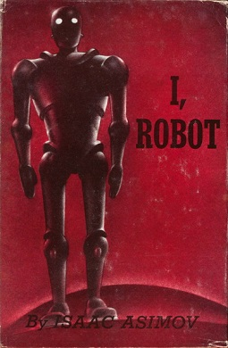
Enter Turing and Asimov
https://en.wikipedia.org/wiki/Turing_test
https://en.wikipedia.org/wiki/Three_Laws_of_Robotics#cite_note-IROBOT-1
The fictional "Handbook of Robotics, 56th Edition, 2058 A.D.“ referenced in the story “Runaround” from I, Robot:
The First Law: A robot may not injure a human being or, through inaction, allow a human being to come to harm.
The Second Law: A robot must obey the orders given it by human beings except where such orders would conflict with the First Law.
The Third Law: A robot must protect its own existence as long as such protection does not conflict with the First or Second Law.
The "standard interpretation" of the Turing test, in which player C, the interrogator, is given the task of trying to determine which player – A or B – is a computer and which is a human. The interrogator is limited to using the responses to written questions to make the determination.

Slide 16
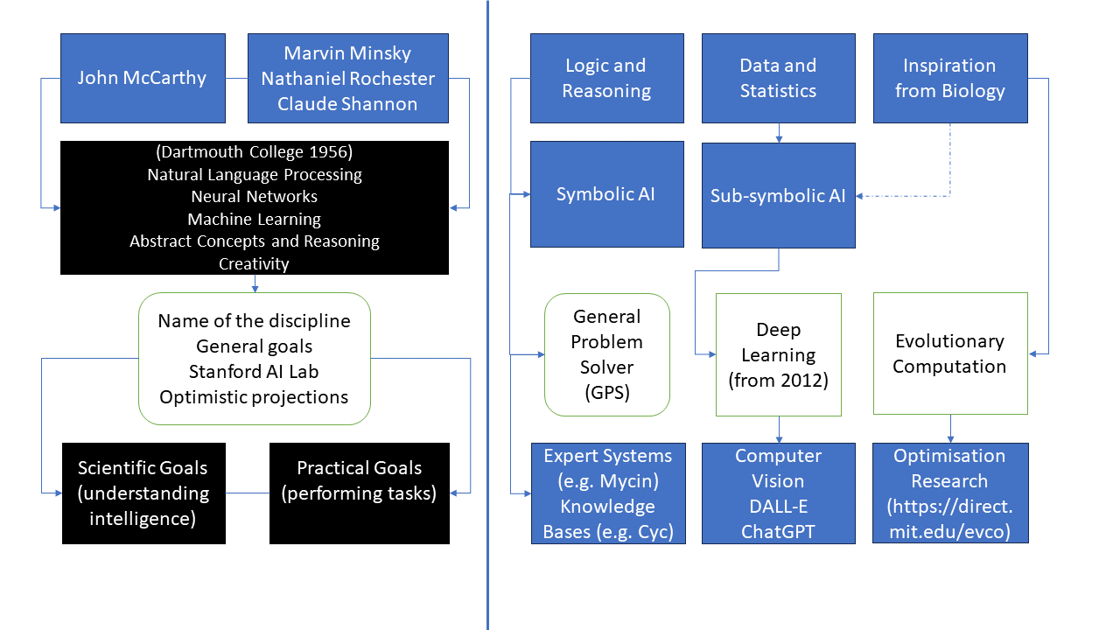
History in One Slide

Slide 17
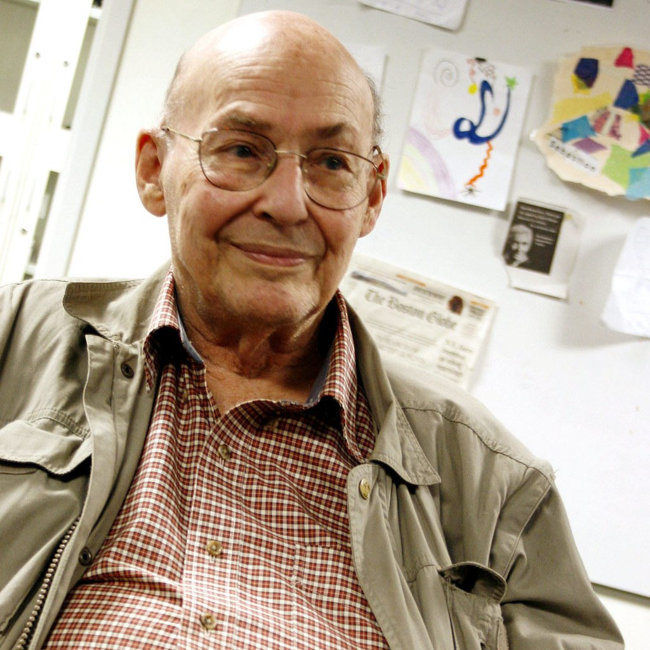
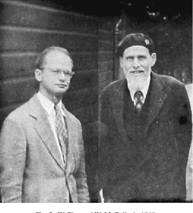
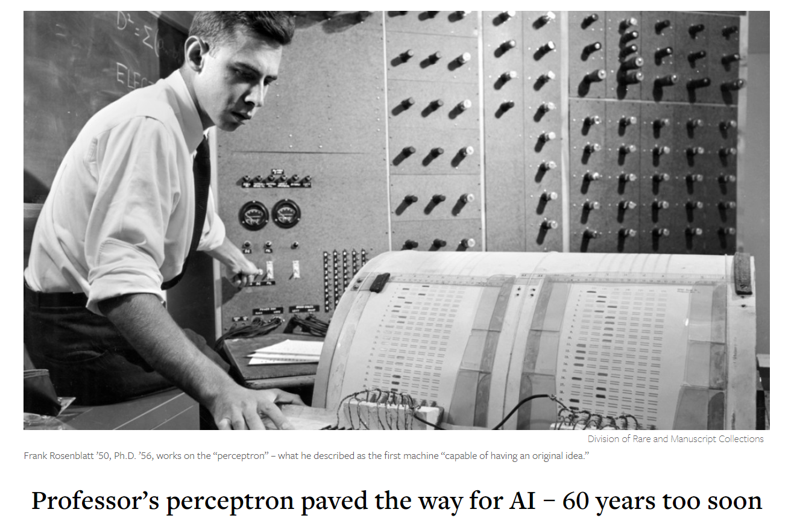
Early Artificial Neural Networks
https://en.wikipedia.org/wiki/Artificial_neuron
https://en.wikipedia.org/wiki/Marvin_Minsky
https://en.wikipedia.org/wiki/Frank_Rosenblatt
“McCulloch - Pitts neuron” - the first mathematical model of a neural network.
Rosenblatt was best known for the Perceptron, an electronic device which was constructed in accordance with biological principles and showed an ability to learn.
Image source: Moreno-Diaz & Moreno-Diaz (2007) “On the Legacy of W.S McCulloch”
Minsky also built, in 1951, the first randomly wired neural network learning machine, SNARC.
This file is licensed under the Creative Commons Attribution 3.0 Unported license
https://www.historyofinformation.com/detail.php?entryid=782
https://news.cornell.edu/stories/2019/09/professors-perceptron-paved-way-ai-60-years-too-soon

Slide 18
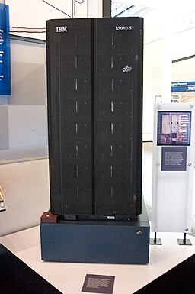
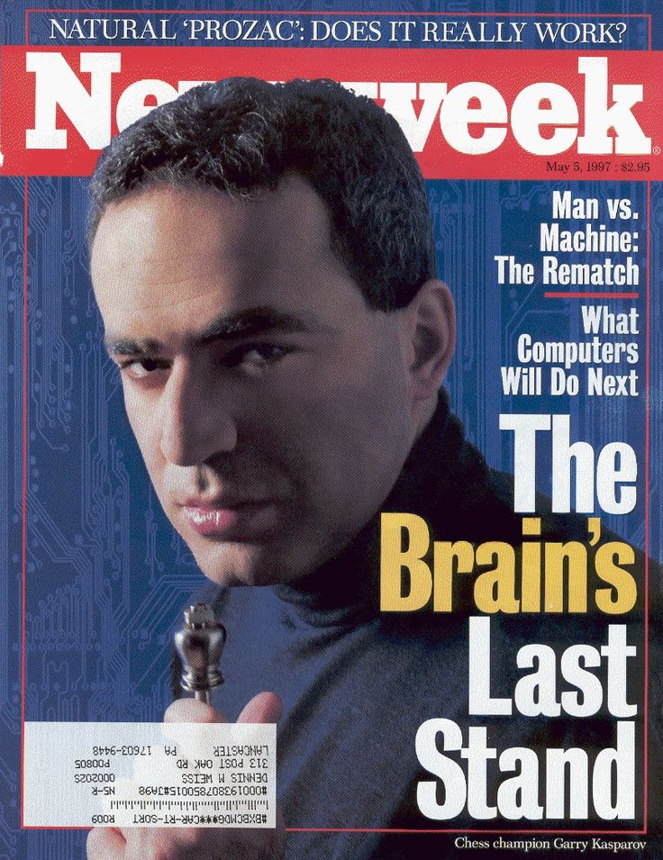
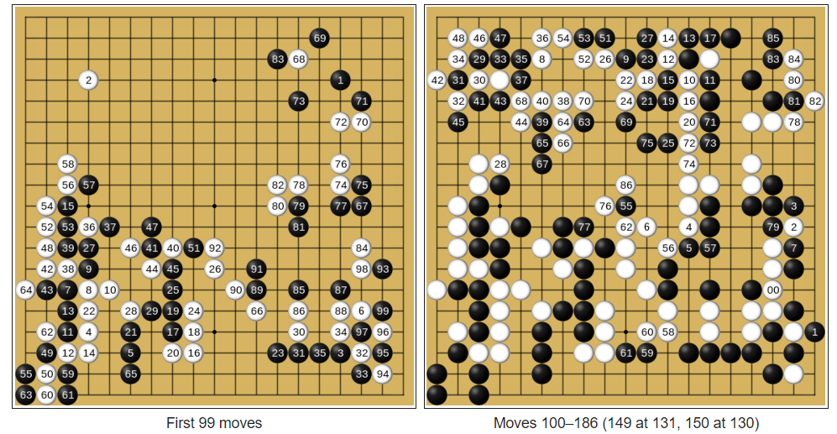
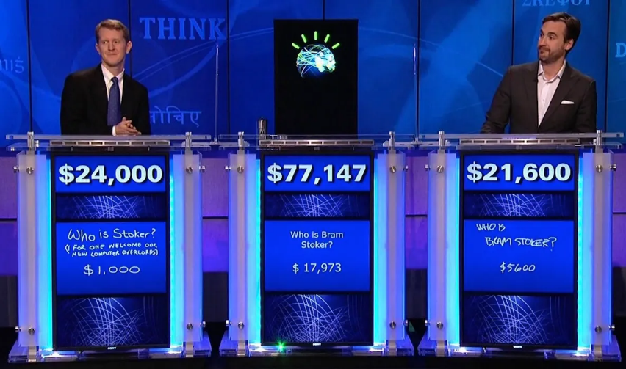
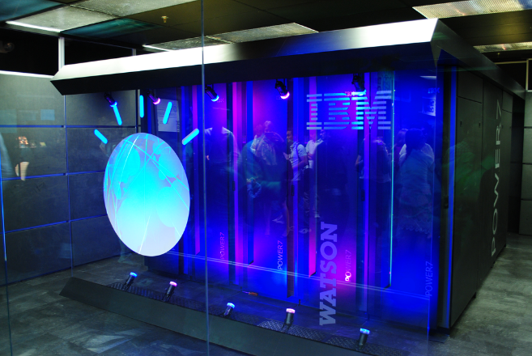
Games and AI
AlphaGo Master (white) v. Tang Weixing (31 December 2016), AlphaGo won by resignation. White 36 was widely praised.
https://en.wikipedia.org/wiki/AlphaGo
Ken Jennings (left) faces off against supercomputer Watson (center) and his fellow Jeopardy champion, Brad Rutter (right).
https://blog.ted.com/how-did-supercomputer-watson-beat-jeopardy-champion-ken-jennings-experts-discuss/
Deep Blue's victory is considered a milestone in the history of artificial intelligence and has been the subject of several books and films.
https://en.wikipedia.org/wiki/Deep_Blue_(chess_computer)

Slide 19
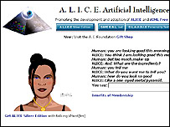
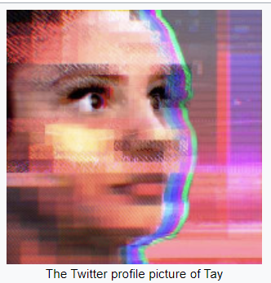

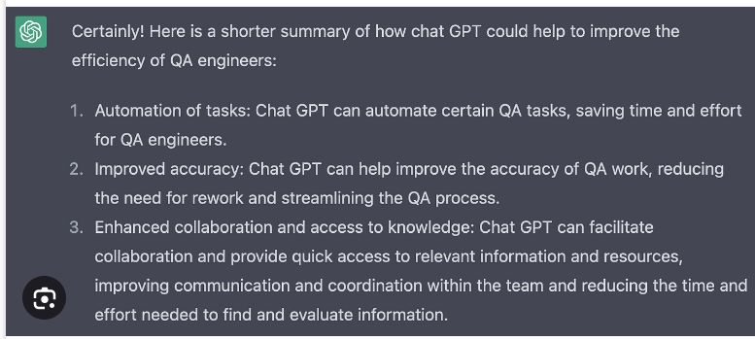
AI Chat Agents
http://news.bbc.co.uk/1/hi/technology/3672424.stm
https://en.wikipedia.org/wiki/Tay_(chatbot)
The Loebner Prize awarded prizes to the computer programs considered by the judges to be the most human-like. The prize is reported as defunct since 2020.
A.L.I.C.E wins multiple times (2000 – 2004).
Tay released by Microsoft Corporation via Twitter in 2016. Bot began to post inflammatory and offensive content. Shut down the service only 16 hours after its launch.
ELIZA is an early natural language processing computer program created from 1964 to 1967^{[1]} at MIT by Joseph Weizenbaum.
https://en.wikipedia.org/wiki/ELIZA
https://web.njit.edu/~ronkowit/eliza.html
https://medium.com/@tadasgym95/chat-gpt-a-game-changing-tool-for-quality-assurance-professionals-8977791e0280

Slide 20

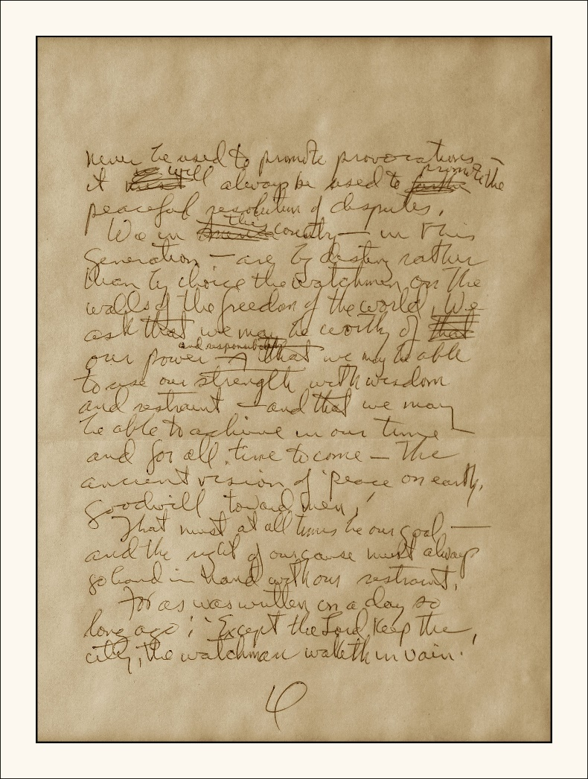
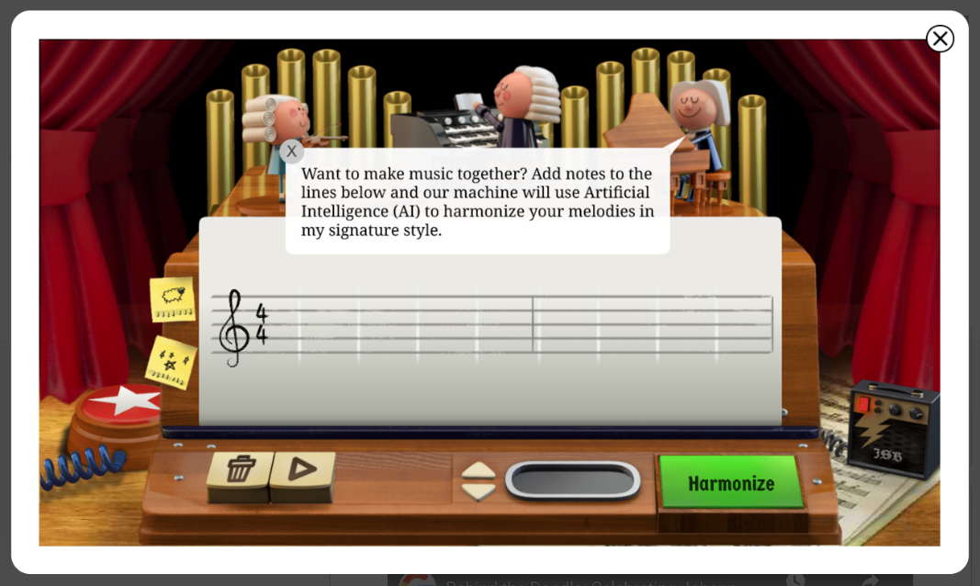
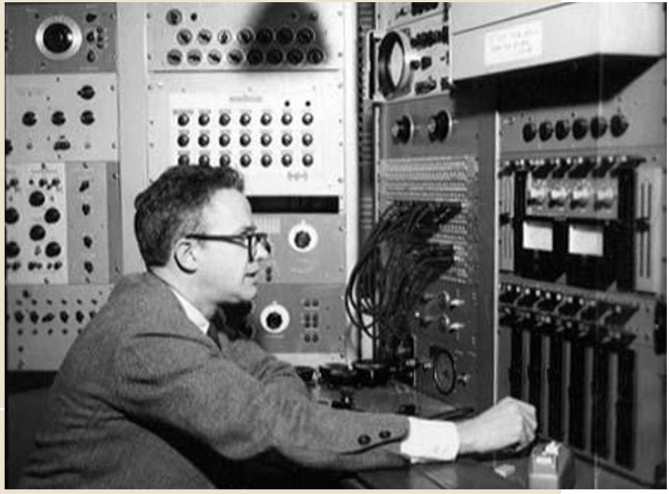

Generative AI
2022
2019
https://en.wikipedia.org/wiki/DALL-E
1970-1990
https://youtu.be/wZF59wIIBLI
https://www.cereproc.com/en/jfkunsilenced
https://www.google.com/doodles/celebrating-johann-sebastian-bach
2018
https://computerhistory.org/blog/algorithmic-music-david-cope-and-emi/

Slide 21
AI Winters
https://en.wikipedia.org/wiki/AI_winter
1966
failure of machine translation
1969
criticism of perceptrons (early, single-layer artificial neural networks)
1971–1975
DARPA's frustration with the Speech Understanding Research program at Carnegie Mellon University
1973
large decrease in AI research in the United Kingdom in response to the Lighthill report
1973–1974
DARPA's cutbacks to academic AI research in general
1987
collapse of the LISP machine market
1988
cancellation of new spending on AI by the Strategic Computing Initiative
1990s
many expert systems were abandoned
1990s
end of the Fifth Generation computer project's original goals

Slide 22
Increasing Interest in Responsible AI
Lethal autonomous weapons (e.g. drones)
Surveillance and persuasion (e.g. Cambridge Analytica)
Biased decision making (e.g. recruitment and selection)
Impact on Employment (e.g. unemployment)
Safety-critical applications (e.g. nuclear; health; climate; epidemic)
Cybersecurity (e.g. anything can be hacked)
Impact on climate change and sustainability

Slide 23
Summary
Defining the field
How governments define AI
Taxonomy of AI
Narrow, General, Super Intelligence
Relationship between AI, Machine Learning, Deep Learning
Brief history
Emerging themes

Slide 24
Looking ahead
The lab: getting started with Python and your coding environment.
Next week focus: machine learning and more history

